Slide 1
Local Control Accountability Plan (LCAP) Committee
Woodland Joint Unified School District
September 17, 2018

Slide 2
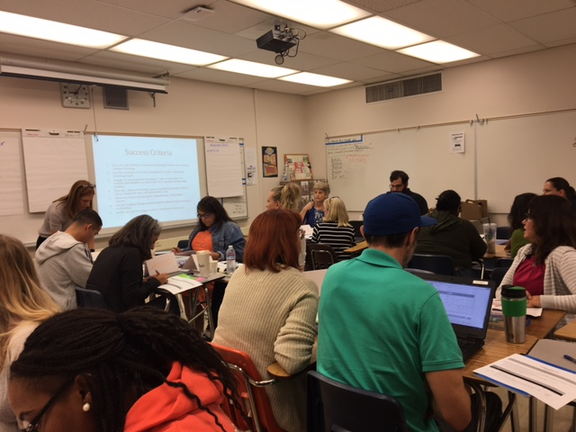
WJUSD Local Control Accountability Plan 2017-20
Year 2
Supports for Schools and Programs District Goals Equity and Access Monitoring and Accountability Professional Development Single Plan for Student Achievement | Supports for Students and Families Foster and Homeless Student support 1:1 chromebooks and wireless access Counseling services Family Empowerment Parent Project
Notes:
County Office LCAP will be essential two plans- one is for the student programs and the other is to the supports to the Districts that we serve. The input that is being collected today will help inform the SDCOE student programs.

Slide 3
Revisiting the Local Control Funding Formula (LCFF)
Greatly simplifies state funding for local educational agencies (LEAs)
ADJUSTMENTS
$
Grade Level
Per Student Base Amount
Demographics (Low income, English Learner, and/or Foster Youth)
11
Notes:
In California the amount of state funding that goes to support K-14 education depends on the overall size of the state budget. The formula to determine K-14 education’s share of California revenue is Proposition 98, which as a general rule of thumb results in approximately 40% of state revenues going towards K-14 education. The passage of Proposition 30 in 2012 increased state revenue, which helped increase funding for K-14
Education. Another way to think about this is that Proposition 98 determines the size of the K-14 education funding pie. Prior to the passage of the Local Control Funding Formula the state divided the pie into slices for local educational agencies—that includes districts, charter schools, and county offices of education— into two categories revenue limits and categorical programs. In effect, the state told local education agencies through the former funding formula how big their slice was and what the filling would be. Now with the Local Control Funding the state slices the pie based on a relatively simple
calculation, which funds local educational agencies the same amount per student with a handful of adjustments for grade levels and demographic characteristics such as low income students, English learners and foster youth. Also under the Local Control Funding Formula the state has largely handed over responsibility for determining the filling of each pie to local educational agencies. The expectation is that funding flexibility improves the ability of local educational agencies to meet student needs compared to the former system where the state tended to direct funding to specific activities.
The Local Control Funding Formula is a major change to how California has supported local educational agencies. Through the local control funding formula the state is providing new decision making power to local educational agencies to act based on the needs they see for students. In addition, this shifts California from treating funding as an input to support students to a resource that is linked to performance expectations.

Slide 4
Linked To
Notes:
Important Idea is that LCFF links student performance and outcomes to the money. LCAP is that document that shows that link. The Local Control Funding Formula is performance focused. A key provision of the Local Control Funding Formula is that local educational agencies must
have in place Local Control Accountability Plans that clearly show the relationship between state priorities oriented towards student outcomes and
how state funding contributed to student success. The Local Control Funding Formula is student-focused. The Local Control funding Formula places flexibility in the hand of local educational agencies with an expectation of improved outcomes for students across a variety of measures. Student need should drive funding use in a way that fits local contexts.

Slide 5
LCAP Big Ideas
LCAP is a 3-year plan, intended to be an iterative, data-driven and student-centered process
The LCAP describes the actions which lead towards the goals and the budget that is aligned to those goals
Actions must be evaluated for effectiveness especially in regards to low income, foster youth, and English Learners
LCAP development and review occurs in consultation with multiple stakeholder groups
LCAP will be taken for Board approval in June

Slide 6
What does it mean to be data-driven and student-centered?
Data-driven = a culture of shared accountability
Teachers and administrators regularly review data on student progress, with a focus on student achievement using nationally normed assessments
Outcomes are agreed upon and actions are evaluated for effectiveness at specified times
Plans are adjusted based on results
Notes:
CDE, as part of the LCAP process, is recommending defining services within the plan – that is, organizing action steps under some larger concept that supports serving students- not about the doing it’s about the serving. This allows the District to move toward systems thinking and build stronger coherence.
For us, service connotes…. And reflects a Theory of Action.

Slide 7
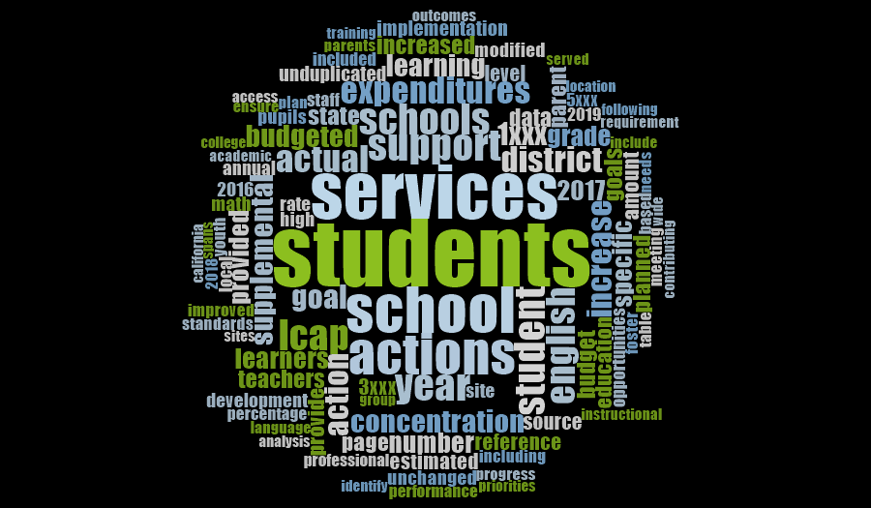
WJUSD LCAP 2017-20
Notes:
The services and the possible strategies that will go in the LCAP should be based on research.

Slide 8
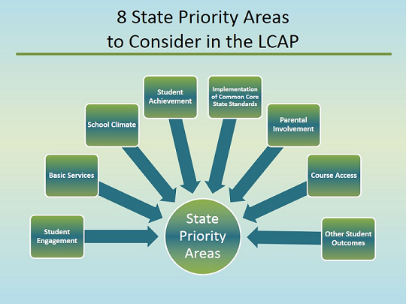
Notes:
The 8 State priority areas must be addressed in each LCAP. For County Offices there are 2 Additional Priorities: Expelled Pupils and Foster Youth
1 Basic Services
2 Implementation of State Standards
3 Parent Involvement
4 Pupil Achievement
5 Pupil Engagement
6 School Climate
7 Course Access
8 Other Pupil Outcomes
9-10 Additional Priorities for County Office of Education: Expelled Pupils & Foster Youth

Slide 9
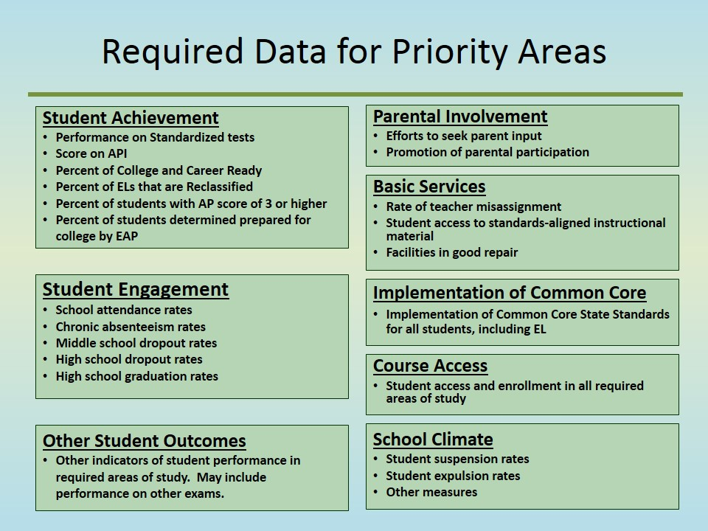
Dashboard
Notes:
The state priorities are expressed as metrics for which the district is expected to develop performance measures to demonstrate how LCFF and the LCAP support student outcomes. The date includes…

Slide 10
Process
Input is collected from staff, students, administrators, parents, and stakeholder groups through surveys and facilitated meetings
LCAP is developed and input is considered in the development of the plan

Slide 11
The Committee’s Role
Advise and contribute your knowledge and experience
Provide input and make recommendations
Represent the interests of our schools and our students
Support WJUSD in achieving the LCAP Goals

Slide 12
Highlights
Alignment of Career Technical Education pathways and development of course outlines that meet the 2013 Model CTE Standards
Professional learning to support the district instructional focus
Decrease in chronic absenteeism
Decreases in suspensions
Decrease in expulsions
Development of Ethnic Studies course options to support the Ethnic Studies graduation requirement; development of a statement of purpose and standards for Ethnic Studies courses

Slide 13
Highlights
Development and consistent use of common district assessments in Reading, Math, and Social-Emotional well-being
Development of a Memorandum of Understanding for dual enrollment with Woodland Community College
Development of partnerships with community organizations and agencies, including a partnership with the City of Woodland to establish Summer at City Hall
Increases in the number of parent workshops through Parent Empowerment
Increases in the Graduation Rate for English Learner, Low Income, and Students with Disabilities
Increase in the number of students meeting a-g requirements
Increase in the number of students at the Prepared level on the College and Career Indicator
Increase in the number of State Seals of Biliteracy awarded

Slide 14
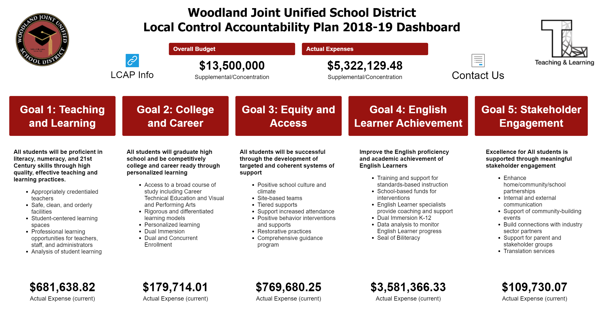
LCAP Monitoring

Slide 15
DRAFT Data Review Schedule
Date of Meeting (WJUSD Board of Trustees) | LCAP Goal | Data to Review
October | Goal 1 = Student Achievement | Smarter Balanced Summative Assessments
November | Goal 2 = College and Career | College and Career Indicator; Graduation Rate
December | Goal 3 = Student Support | Suspension Rate; Absenteeism
January | Goal 4 = English Learner Achievement | EL achievement and Reclassification
February | Goal 5 = Stakeholder Engagement | Community Input and Participation

Slide 16
Schedule of LCAP Meetings
Monday, November 26
Monday, January 28
Monday, March 11
Monday, April 15
Monday, May 20
All meetings 6 -7:30 pm at WJUSD District Office

Slide 17
Who Should be on this Committee?
A representative from the School Site Council of every school site
A representative from the District English Learner Advisory Committee
Representatives from Certificated and Classified Units
Other stakeholder groups as appropriate

Slide 18
Questions?

